Slide 1
N-body Simulation

Slide 2


Slide 3
N-body Simulation
Approximates the motion of particles that interact with one another through some type of physical forces
The types of particles that can be simulated ranging from celestial bodies to individual atoms in a gas cloud
Motion of the particles on the bodies themselves is neglected

Slide 4
N-body Simulation
How are they done?
Is simple in principle, because it involves integrating ordinary differential equations defining the particle motions in Newtonian gravity

Slide 5
N-body Simulation
Newton's law (1686) of universal gravitation:
a particle attracts every other particle in the universe using a force that is directly proportional to the product of their masses and inversely proportional to the square of the distance between them

Slide 6
N-body Simulation
Newton's laws of motion (Second law):
In an inertial reference frame, the vector sum of the forces F on an object is equal to the mass m of that object multiplied by the acceleration a of the object:
F = ma

Slide 7
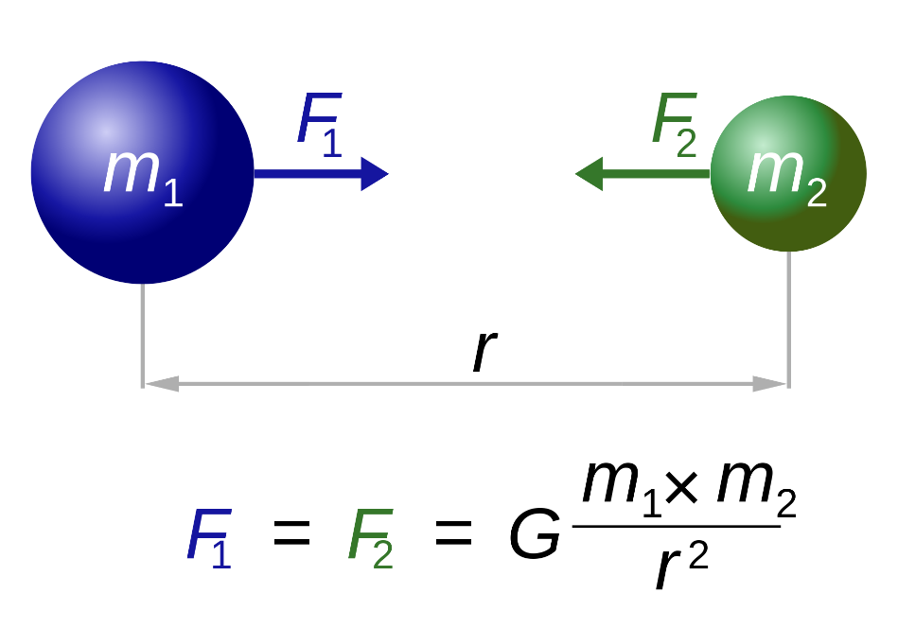
N-body Simulation
Newtonian gravitational force equation
The total force on each particle is the superposition of the forces imparted by each of the other particles:
The gravitational constant
G = 6.67 × 10⁻¹¹ Nm² / kg²

Slide 8
N-body Simulation
Given a group of particles, we find the net gravitational force exerted on any of them by using the principle of superposition
This is a general principle that says a net effect is the sum of the individual effects.
For n interacting particles, we can write the principle of superposition for gravitational forces as
F₁ = F₁₂ + F₁₃ + F₁₄ + . . . + F_{1n}

Slide 9
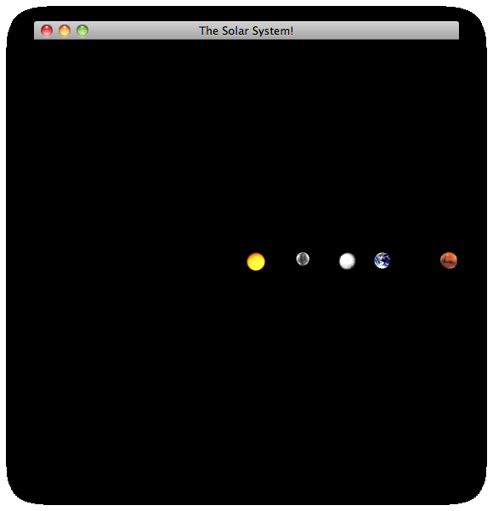
N-body Simulation
Given a group of particles, we find the net gravitational force exerted on any of them by using the principle of

Slide 10
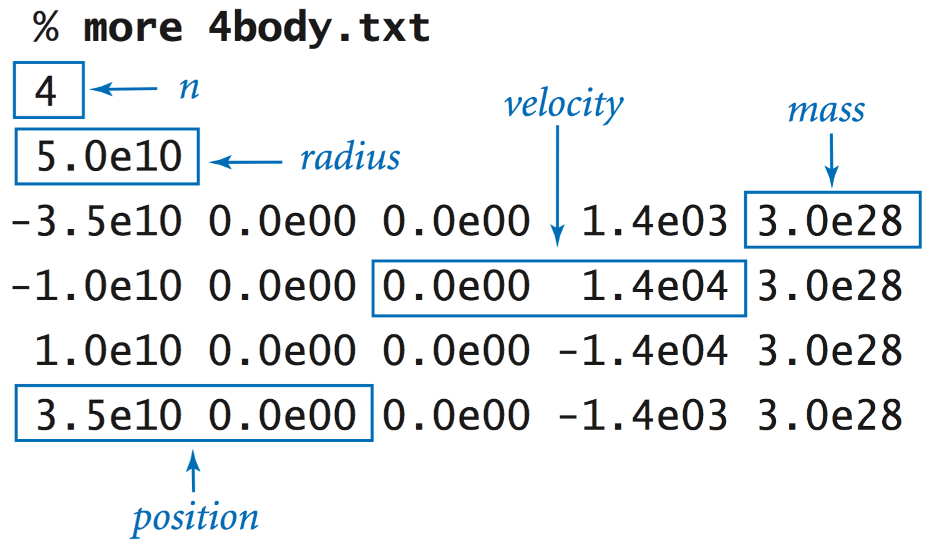
N-body Simulation

Slide 11
N-body Simulation
Moving a Body
Assuming no other forces, body moves in straight line
Newton laid out the formulas needed to solve the N-body problem for gravity some 300 years ago
Units:
x The position of the body.
v Velocity is the rate of change of the position (m/s)
a Acceleration is the rate of change of the velocity and is also the second derivative of the position (m/s²)

Slide 12
N-body Simulation
Units:
mass kg
Force N (newton)
One newton is the force needed to accelerate one kilogram of mass at the rate of one meter per second squared in direction of the applied force kg·m/s²

Slide 13
N-body Simulation
Moving a Body
Find external force F
Given external force F, acceleration a = F/m.
Use acceleration (assume fixed) to compute change in velocity.
Use velocity to compute change in position.

Slide 14
N-body Simulation
Gravitational Forces
To update the particle velocities at each time step-need to compute the gravitational forces
Since the force depends on the relative positions of particles, it changes constantly and must be inside your time loop
On the other hand, you need it to update the velocities and therefore the positions - it must come at the beginning of the time loop
The acceleration of a single particle is the sum of forces exerted by all other planets on it (the principle of superposition)

Slide 15
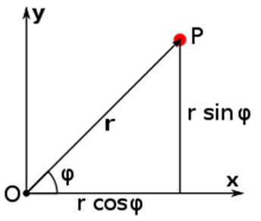
N-body Simulation
Gravitational Forces
For each planet, you will need a loop over all other planets to sum up the force they exert on it
You will need to do this for all planets.
Pairwise Gravitational Forces

Slide 16
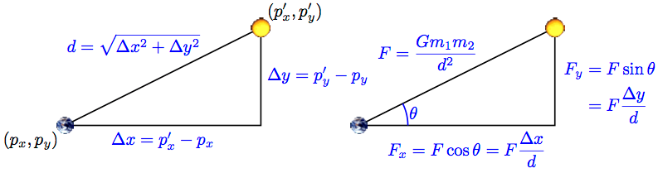
N-body Simulation
Pairwise Gravitational Forces
x- and y- Force Components: Since the velocity is broken down into x- and y- components, the force needs to be too.

Slide 17
N-body Simulation
Δx and Δy
These are the distances in the x- and y- directions from the first planet to the second one, and can be negative. You should not take the absolute value of the differences between their x- and y- positions.
Acceleration:
Compute the acceleration on each particle using the formulas a_{x} = F_{x} / m and a_{y} = F_{y} / m ,where m is the mass of the particle, and F_{x} and F_{y} are the sum of all pairwise forces exerted on the particle.

Slide 18
N-body Simulation
Velocity:
Using the acceleration you just computed, update the velocity (v_{x}, v_{y}) to (v_{x} + Δt a_{x}, v_{y} + Δt a_{y})
This gives you the direction and speed each particle should move at the current time, taking into account the gravitational pull of every other particle

Slide 19
N-body Simulation
Order of computation:
Remember that you must update the velocity of every particle before you can update any positions
Even though your program computes these velocities one after the other, you have to maintain the illusion that all planets are moving at the same time. For instance, if you update the Earth's position before computing Mars's velocity, then you will end up computing Mars's velocity based on Earth's future position, rather than its current position.

Slide 20
Problem:
planets fly off the top right corner of the screen
Problem: flipped the order of particles when computing Δx and Δy. As a result, the signs on all your distances are all reversed, and gravity is repelling planets from each other instead of attracting them.

Slide 21
Problem:
planets all disappear or jump to the top left corner
Check your loop for computing the pairwise forces between particles. Are you computing the force exerted by a particle on itself (e.g. Earth's gravitational pull on itself)? If you are, do the computation by hand to see exactly what it would give you. That should help you understand why this is a bad idea, and why the planets jump the way they do

Slide 22
Problem:
planets go around the sun, then zoom off the lower left corner

Slide 23
Problem:
planets go around the sun, then zoom off the lower left corner
You are not summing up the pairwise forces correctly. Run your program with a small value of T (e.g. 51000) so it runs for only two or three time steps. Print out the value of every variable before and after you change its value (or right after you first initialize it). Include enough information in the print statement so you can tell which variable you are printing out.

